Slide 1

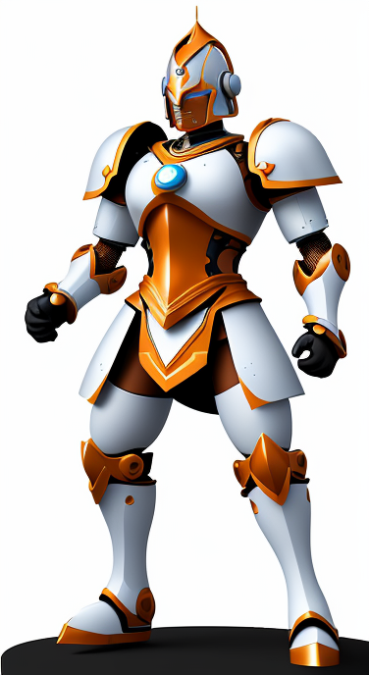

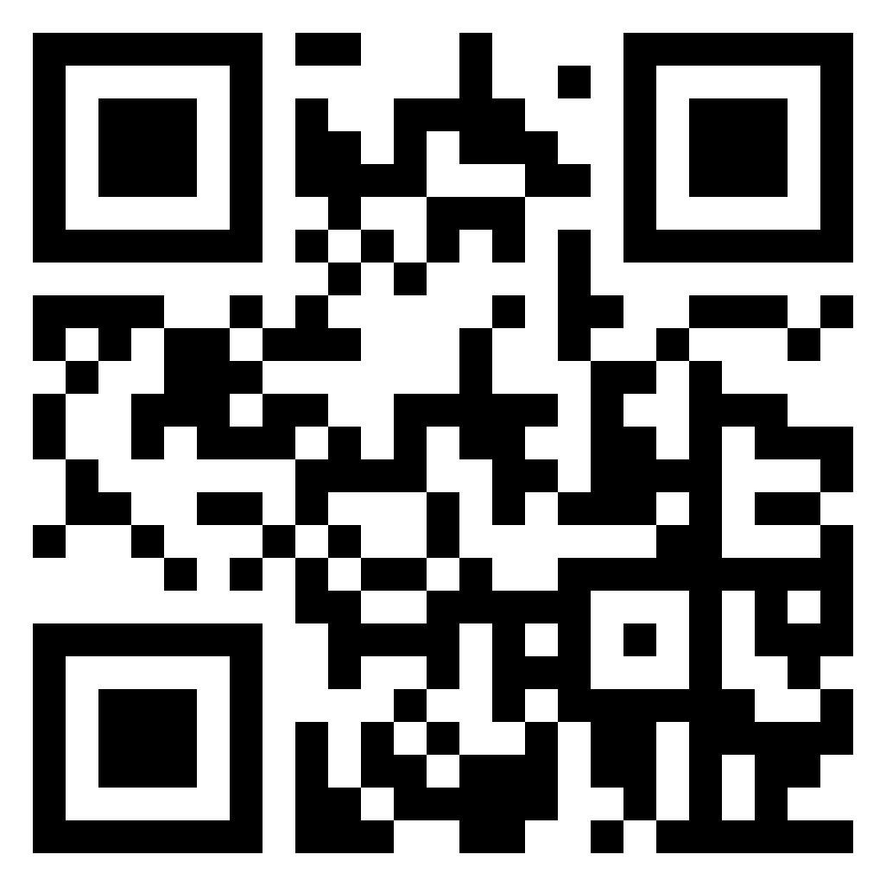

UofT Computer Vision Club
Paper Breakdown Series
Denoising Diffusion Probabilistic Models
Follow us on social media
youtube.com/@uoftcv
github.com/ut-cvdg/paper-breakdown
Generated by a diffusion model!

Slide 2


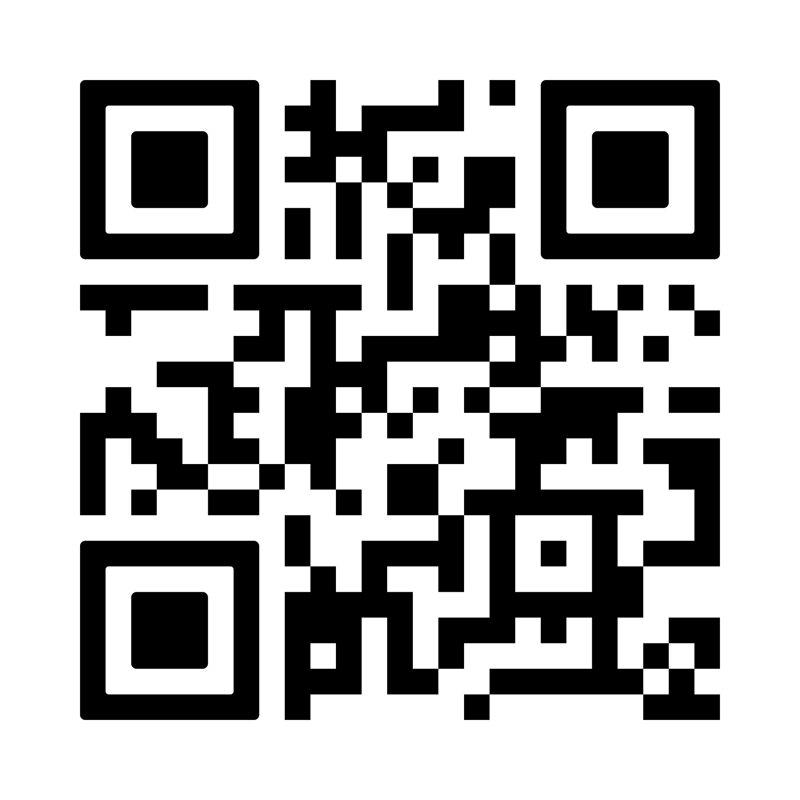



UofT CV is sponsored by
Sign up for the GitHub Student Developer Pack:
https://education.github.com/benefits

Slide 3
About the Club
We are a student club for Computer Vision and Machine Learning affiliated with the University of Toronto.
We run:
paper “discussions” for recent papers
conference-style research orals for pre-prints
breakdowns of well-known papers
If you want to help run our club, talk to any of us or drop an email contact@cvdg.tech.

Slide 4
Diffusion is a generative model
Interesting in sampling from complicated high-dimensional probability distributions
Can be conditional or unconditional

Slide 5


Our example: sampling images unconditionally
Give me an image
Ok
Us
Model that lets you sample an image of a cat

Slide 6
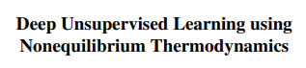
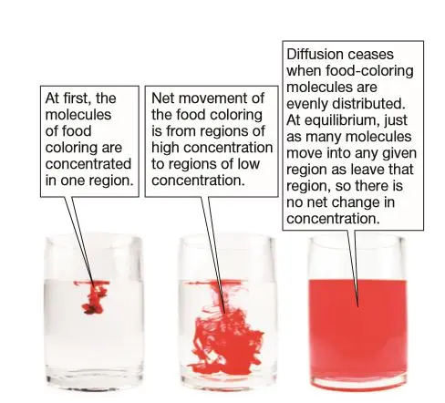
Inspiration from a physical process
First diffusion paper title ->
Diffusion: The net movement of “something” from an area of high concentration to low concentration
Equilibrium: equal concentration (or ~equal concentration for practical purposes)

Slide 7
Programming a diffusion process for images
Discrete instead of continuous
Must add noise “slowly”
Equilibrium: the image looks like it was sampled from a normal distribution
Our diffusion algorithm:
image = an image of a cat
for t in range(T):
image = image with a little bit of noise added to it
return image

Slide 8
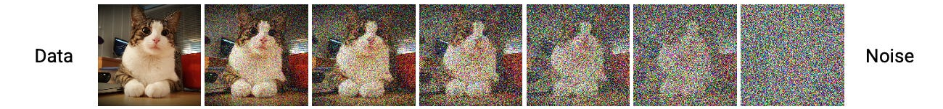
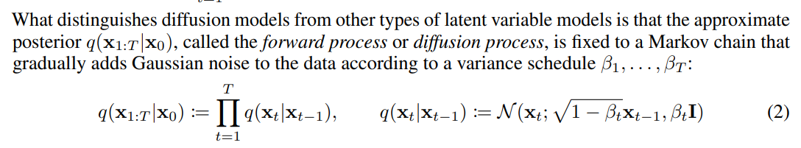
Programming a diffusion process for images
Hyperparameter
The adding a little bit of noise step in our algorithm

Slide 9
Programming a diffusion process for images
Hyperparameter
The adding a little bit of noise step in our algorithm
There’s no best or correct way to do this; it’s a way to do it that works reasonably well

Slide 10
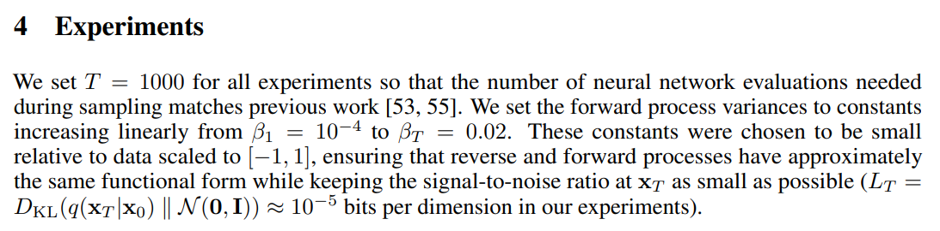
Programming a diffusion process for images

Slide 11
Programming a diffusion process for images
Our diffusion algorithm now:
T = 1000 # number of timesteps
betas = np.linspace(start=b_0, stop=b_T, num=T)
x_0 = an image of a cat
for t in range(T):
Sample x_t from
return x_T

Slide 12
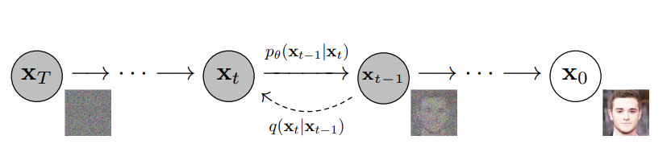
The reverse process
We wish to devise or learn an algorithm to sample in the reverse direction (sample x_{t-1} given x_{t})

Slide 13
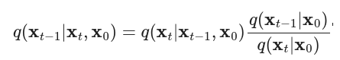
Apply Bayes’ rule!

Slide 14
Apply Bayes’ rule!
Likelihood

Slide 15
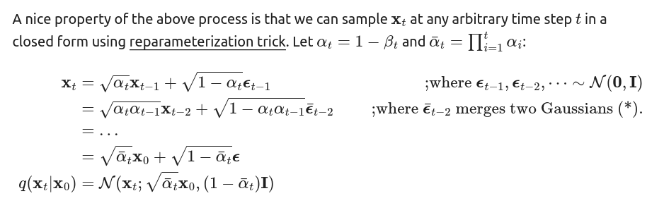
Apply Bayes’ rule!
Prior
Credit: https://lilianweng.github.io/posts/2021-07-11-diffusion-models/

Slide 16
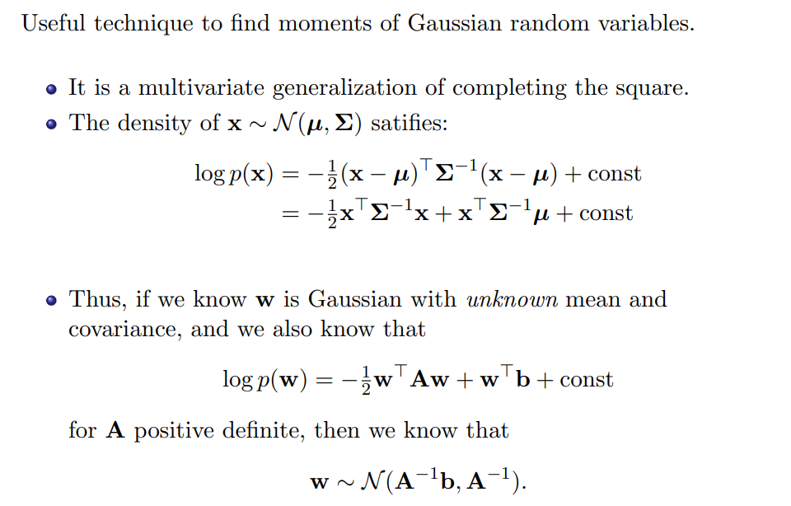
The reverse process is Gaussian!
Slide credit: https://erdogdu.github.io/csc412/

Slide 17
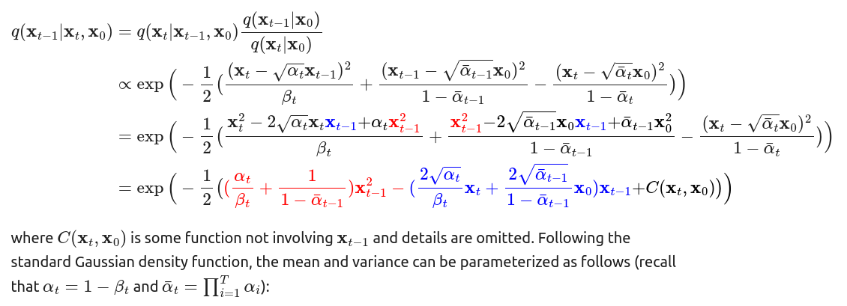
You can also see this explicitly, but it’s gross
Credit: https://lilianweng.github.io/posts/2021-07-11-diffusion-models/

Slide 18
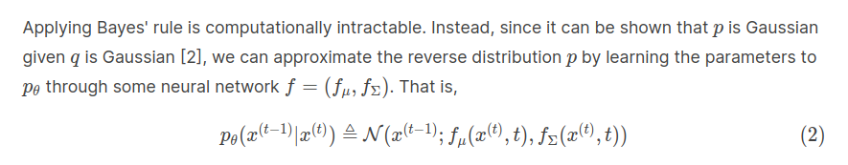
What does this mean?
We know the reverse distribution is Gaussian, so we can formulate learning the reverse process as learning the parameters (mean and covariance) to this Gaussian distribution!

Slide 19
What is our training objective?
Call our true reverse distribution p. Given some training data (e.g. a dataset of images of cats), how do we make p theta close to p?

Slide 20
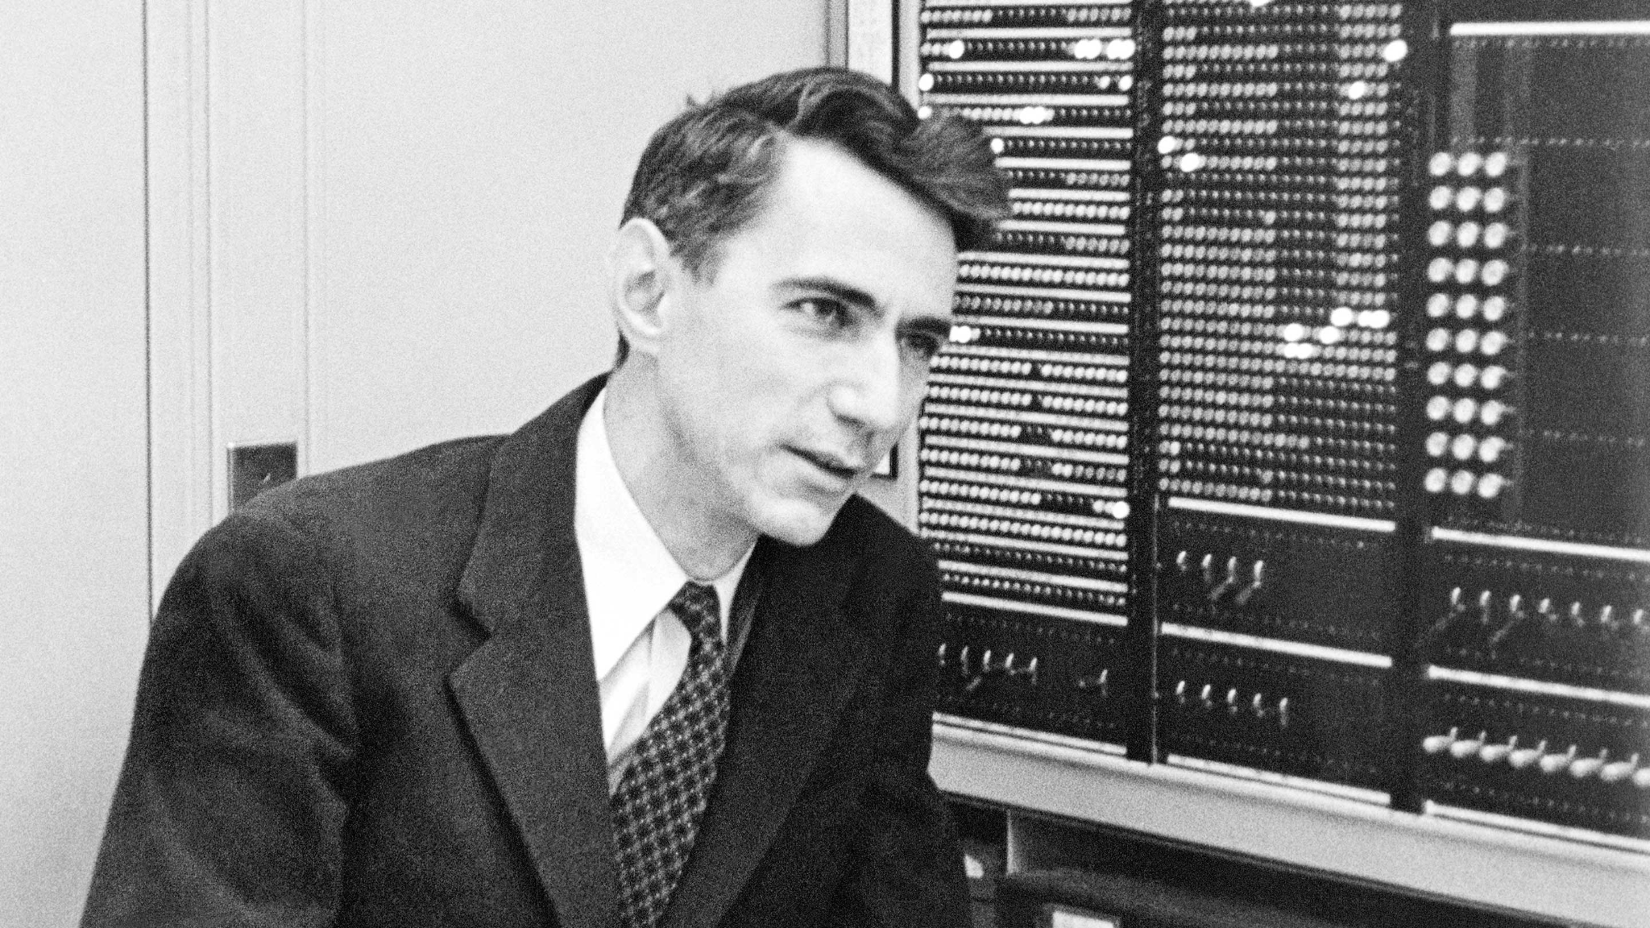
A detour into variational inference
How can we quantify a notion of distance or similarity between two probability distributions?
By computing the expected value of an information function!

Slide 21
Information function
A function from (0,1] to ℝ that tells us the amount of information we get from an event (with an underlying probability distribution) occurring; high when an unlikely event occurs and low when a likely event does. More formally:
I is monotonically decreasing
I(1) = 0; an event guaranteed to occur gives us no information once it does
I(p₁p₂) = I(p₁) + I(p₂); the information from independent events occurring is the sum of the information from each such event

Slide 22
What form does the information function take on?
One more assumption: the information function is twice continuously differentiable
Reasonable since we may want to do calculus with it
This extra assumption gives us that I(p) = -log_{b}(p) for some base b.
To arrive at this result, take a mixed partial derivative of property 3 (I(p₁p₂) = I(p₁) + I(p₂)) in p₁ and p₂, substitute u=p₁p₂, solve for the general form of the resulting second order ODE, and narrow down this general form using properties 1 and 2 (monotonically decreasing and I(1)=0). Try this on your own!
The base b of our information function can be thought of as specifying a unit of information, colloquially called shannons or bits for base 2 and nats when using the natural logarithm.

Slide 23
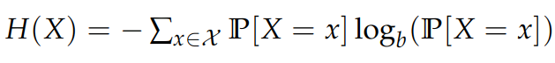
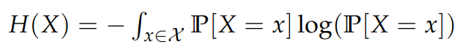
Entropy
Next, we define the entropy of a probability distribution as the expected information over its corresponding events, commonly written as:
or

Slide 24
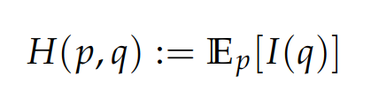
Cross-entropy and exponential families
Let’s say we fix a distribution p and wish to approximate it by q. Define the cross-entropy of q relative to p as
Key facts:
We can show that H(p) ≤ H(p,q) (try this on your own too!)
H(p) = H(p,p)
There is a broad characterization of probability distributions called exponential families that include the likes of Gaussian, geometric, Poisson, exponential, Bernoulli, and many more distributions. This characterization allows us to prove general facts like the convexity of log-likelihood, entropy, and cross entropy for a vast number of common distributions.

Slide 25
KL divergence
So, if we take p and q as belonging to an exponential family, it’s clear that since we are working in a convex search space, minimizing cross-entropy H(p,q) brings us closer to H(p) and gives us a better “encoding” or approximation of p. In other words, minimizing
KL(p||q) := H(p,q) - H(p)
is a good choice of objective function when wanting to find an approximation q to p; this quantity is called the KL divergence of p with respect to q.

Slide 26
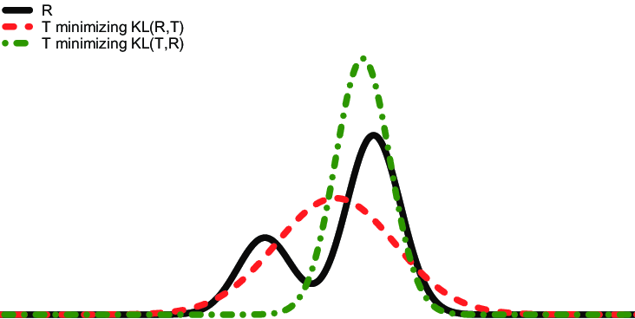
KL divergence is not symmetric!
There are several examples of KL(p||q) ≠ KL(q||p), but KL(q||p) is often the more tractable of the two.
This is why we say KL divergence quantifies “similarity” and not distance. Experimentally, the absence of symmetry does not matter if we know p and q belong to the same exponential family.
Source: https://www.researchgate.net/figure/Order-of-the-arguments-of-the-Kullback-Leibler-divergence-zeroforcing-and-zero-avoiding_fig3_24280227

Slide 27
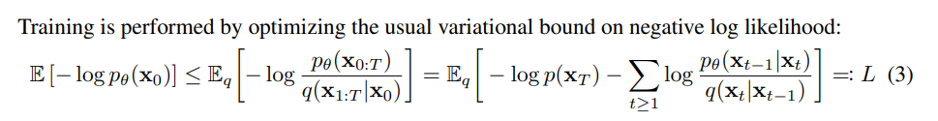
KL Divergence in recent diffusion papers
Most training objectives in the original formulations of diffusion models involved taking KL divergence and maximizing/minimizing a variational lower/upper bound on negative log-likelihood or KL divergence.
Is this still the case?

Slide 28
No, not entirely

Slide 29
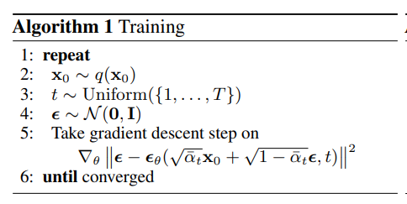
DDPM and new diffusion training objectives
Sample an image from our training dataset
Sample timestep t
Sample noise to add to create a sample x_{t}
Neural network that takes in a sample x_{t} and the timestep t to predict back the noise epsilon
Simple MSE loss function

Slide 30
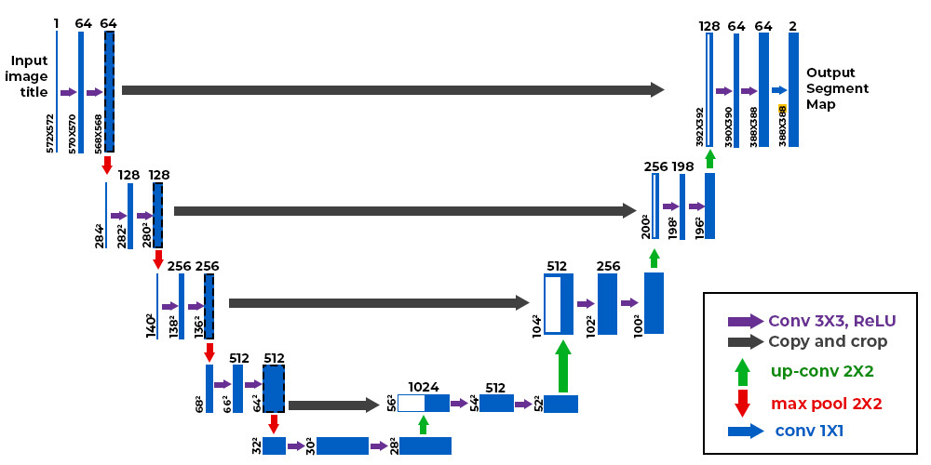
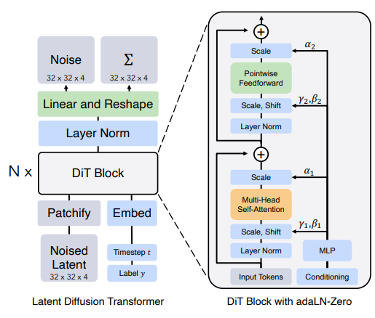
DDPM and new diffusion architectures
What architectures (“backbones”) are frequently used to predict back this noise vector?
U-Net (originally developed for biomedical imaging!): https://arxiv.org/abs/1505.04597
A vision transformer, dubbed the DiT (diffusion transformer): https://arxiv.org/abs/2212.09748
Examples: Stable diffusion uses a U-Net and OpenAI Sora uses a diffusion transformer, both in pre-trained latent spaces for dimensionality reduction.

Slide 31
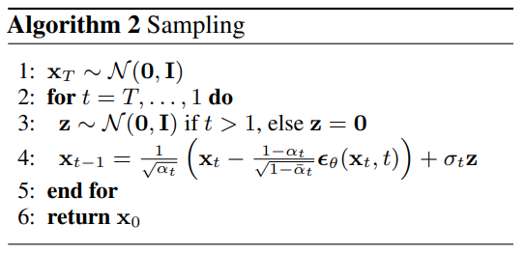
DDPM and new sampling algorithms
Sample an isotropic gaussian image
Sample x_{t-1} given x_{t}… where does this formula come from??

Slide 32
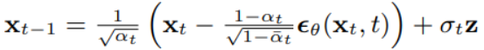
DDPM and new sampling algorithms
Lilian Weng (working on safety at OpenAI) has an excellent blog post (https://lilianweng.github.io/posts/2021-07-11-diffusion-models/#nice) walking through the algebra to lead you to this result we need to craft our sampling algorithm:
I decided to leave the details out of this presentation not because they use any mathematically sophisticated tools, but because tedious notation and algebraic tricks for Gaussian distributions are better left for you to read through on your own. Give it a try!

Slide 33
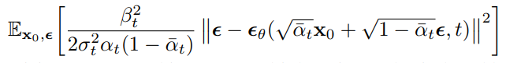
DDPM and new sampling algorithms
There still remains strong connections to variational inference:
Interesting to understand how diffusion models were pioneered by this rich area of machine learning
Log-likelihood-based benchmarks will never go away
Another class of diffusion models called score-based models
Variational inference can give training objectives similar to our MSE one:

Slide 34
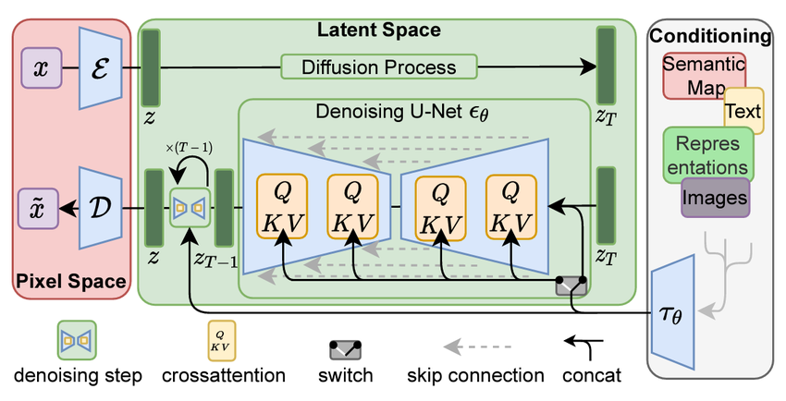
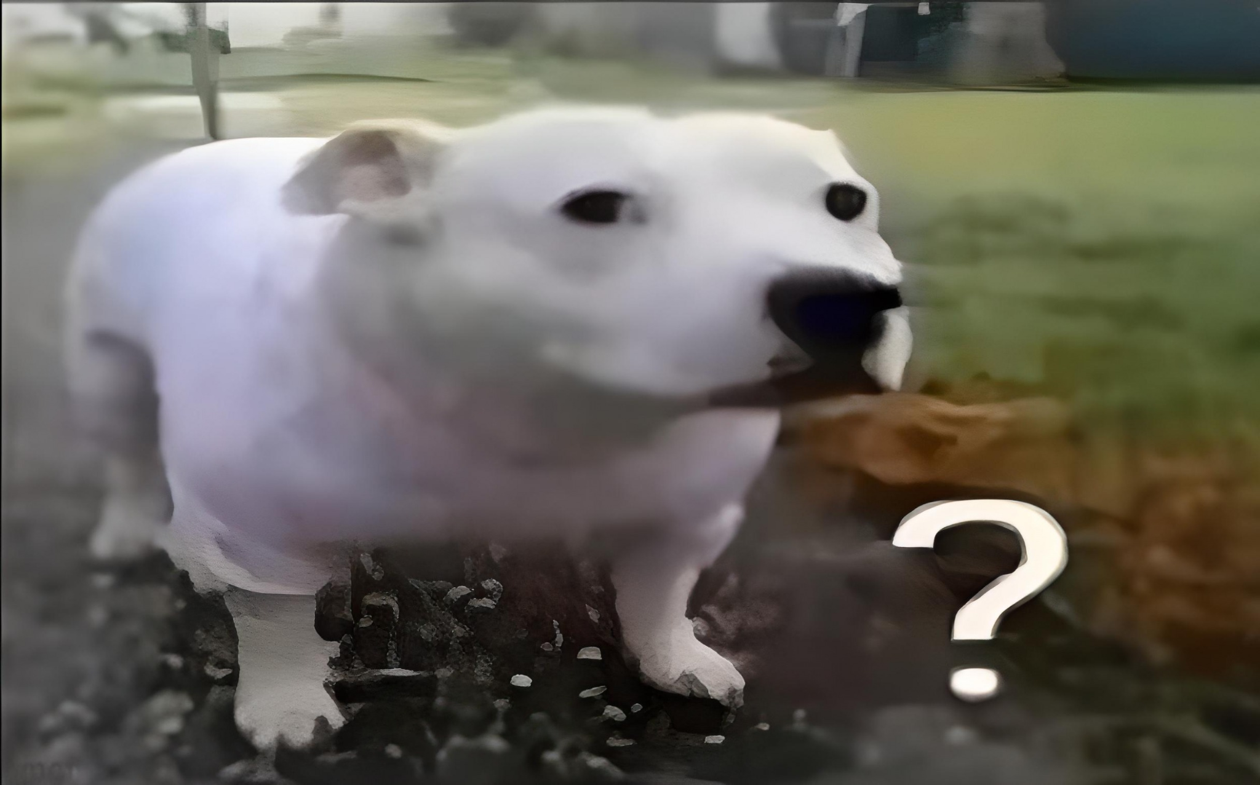
Conditioning on sequences and dimensionality reduction
from https://arxiv.org/abs/2112.10752

Slide 35
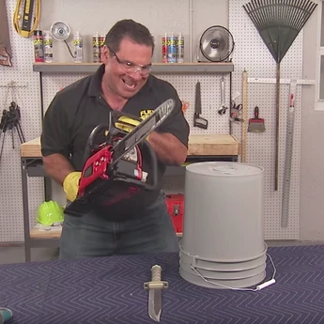



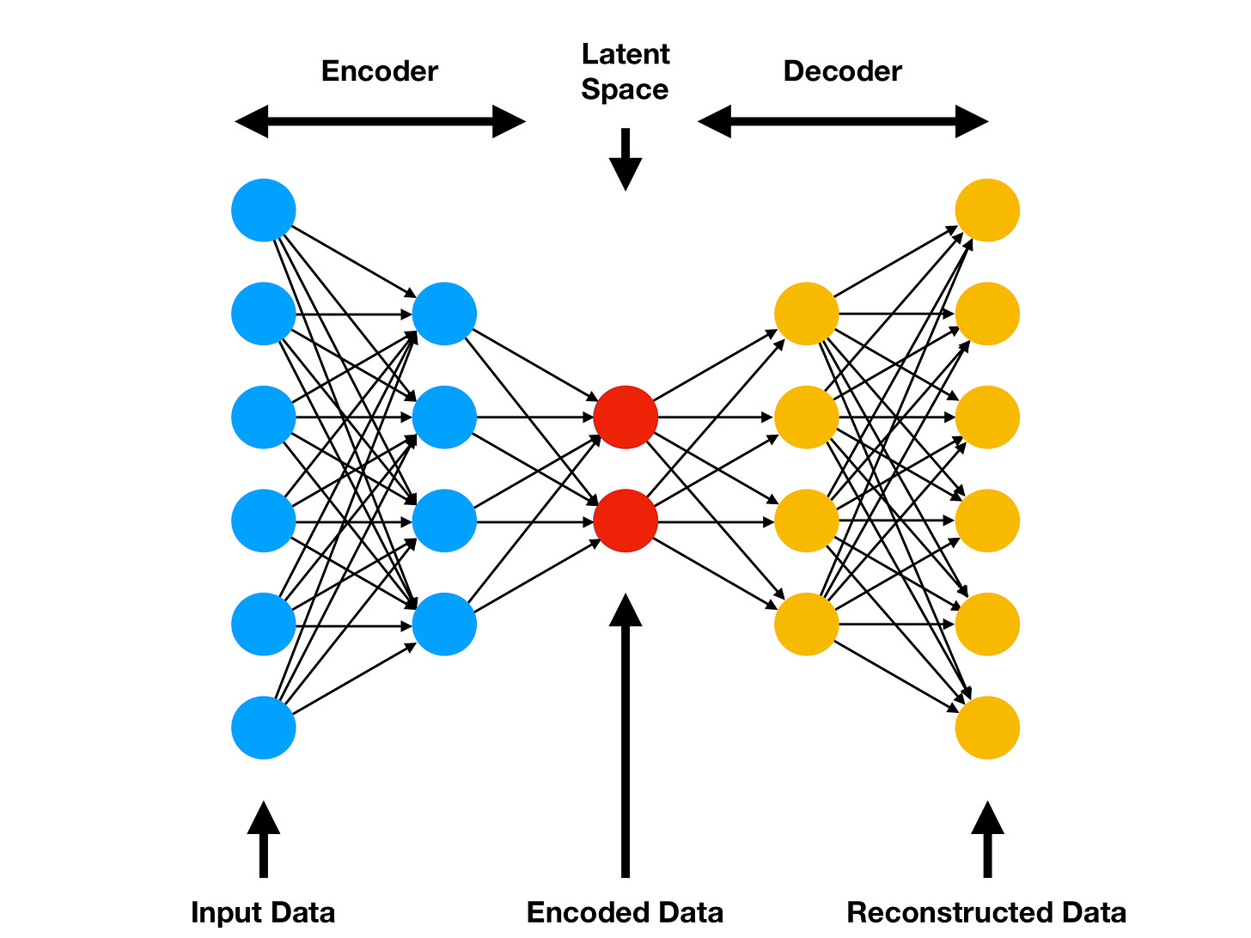
Conditioning on sequences and dimensionality reduction
Diffusion Model

Slide 36
Conditioning on sequences and dimensionality reduction
Add conditioning CLIP vector somewhere
Diffusion Model
Output noise vector prediction
Transformer Encoder
Autoencoder Encoder
Conditioning
Autoencoder Decoder
Input

Slide 37

Conditioning on sequences and dimensionality reduction
Phew

Slide 38
Open discussion and question period

